Slide 1
Unit 4 IMAGE RESTORATION
Hours:[4 hrs]
Presented By
Er.Harendra Bikram Shah
(Lecturer)
Department of Computer Engineering

Slide 2
OUTLINES
4.1. A model of The Image Degradation / Restoration Process,
4.2. Noise Models Restoration in the Presence of Noise-Only Spatial Filtering
4.3 Types of noise (White noise, salt & pepper noise, Impulse noise, Gaussian noise, Rayleigh noise)
4.4. Periodic Noise Reduction by Frequency Domain Filtering

Slide 3
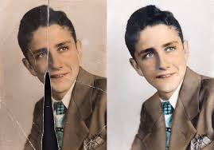
Introduction to Image Restoration
process of enhancing or recovering the quality of a digital image that has been degraded or damaged.
various factors such as noise, blurring, compression artifacts, or other distortions during acquisition, transmission, or storage.
The goal of image restoration is to improve the visual appearance of the image, making it closer to its original or desired state.

Slide 4
Introduction to Image Restoration
Common methods include:
Noise Reduction:
Deblurring:
Artifact Removal:
Resolution Enhancement:
Color Correction:
Image restoration is widely used in various fields,
medical imaging
satellite imagery
Surveillance
Photography
video processing

Slide 5
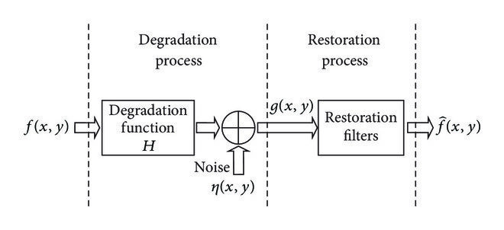
Image Degradation /Restoration Process

Slide 6
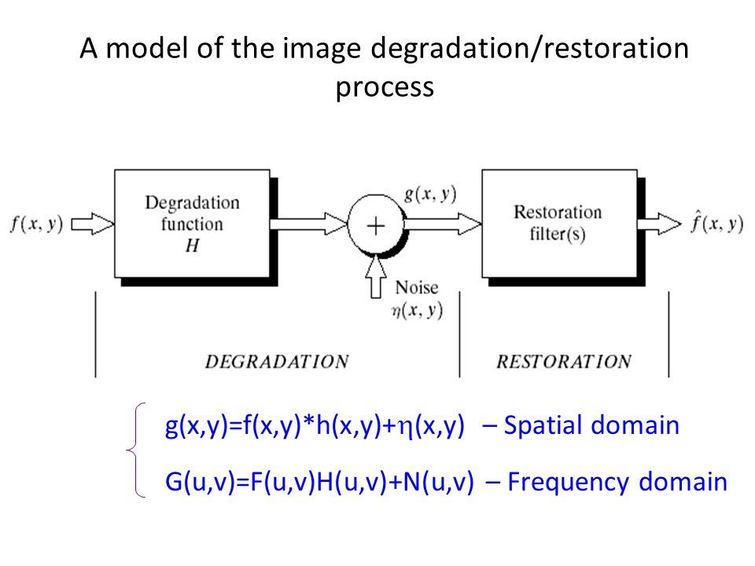

Slide 7
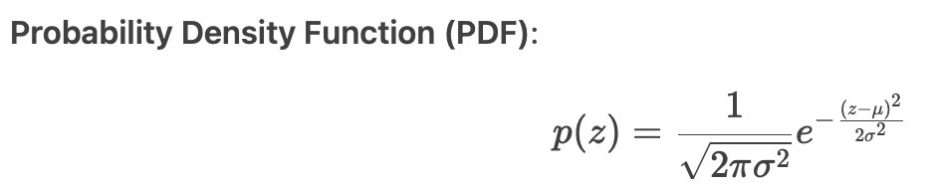
Noise Models Restoration in the Presence of Noise-Only Spatial Filtering
In image processing, noise refers to unwanted random variations in pixel intensities that degrade image quality.
Noise can arise from various sources, such as sensor imperfections, transmission errors, or environmental factors.
To restore noisy images, spatial filtering techniques are commonly used, where pixel values are modified based on their local neighbourhoods.
Noise Models
a. Gaussian Noise
Definition: Additive noise where pixel intensities are perturbed by values from a normal (Gaussian) distribution.
Characteristics:
Additive: Inoisy=Ioriginal+ηInoisy​=Ioriginal​+η, where η∼N(0,σ2)η∼N(0,σ2).
Symmetric around the mean.
Occurrence:
Thermal noise in electronic circuits.
Low-light conditions in cameras.
Effect on Images:
Smooth, grainy distortions (similar to film grain).

Slide 8
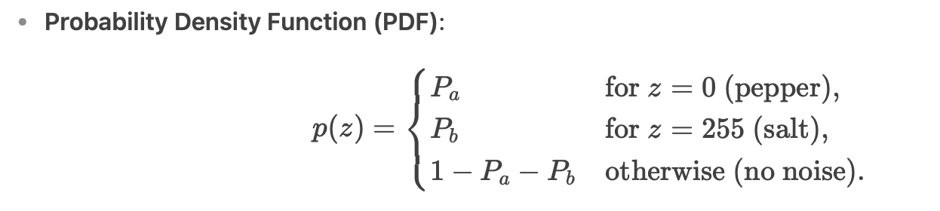
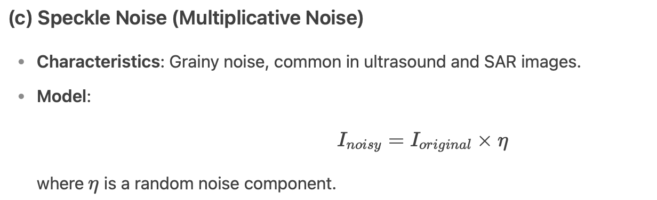
Noise Models
(b)Salt & Pepper Noise (Impulse Noise)
Definition: Random occurrences of extreme bright (salt) and dark (pepper) pixels.
Characteristics:
Salt: White pixels (255 in 8-bit images).
Pepper: Black pixels (0 in 8-bit images).
Sparse but highly disruptive.
Occurrence:
Faulty camera sensors.
Transmission errors (e.g., bit errors in JPEG).
Effect on Images:
Black and white speckles scattered across the image.

Slide 9
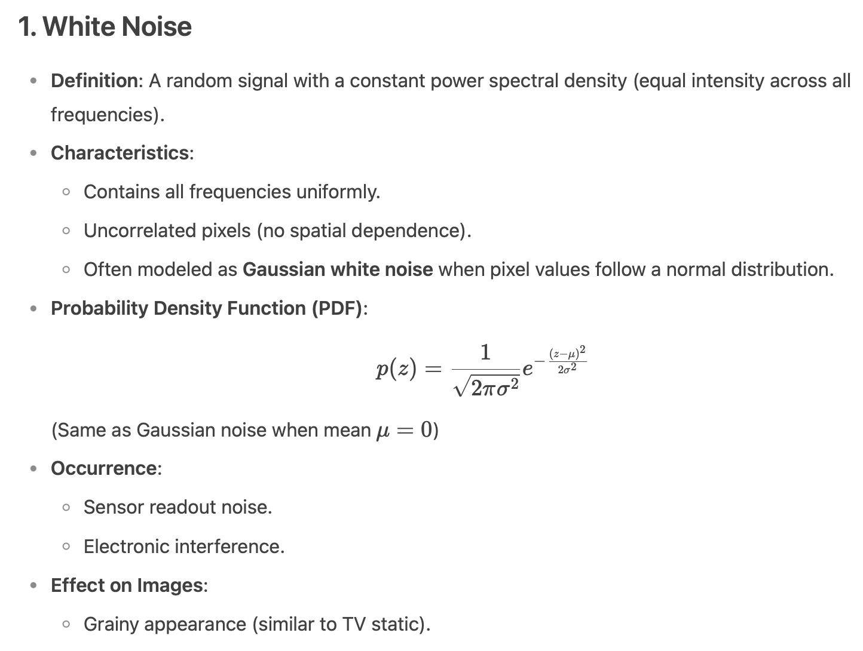
Additional Noise Models

Slide 10
Additional Noise Models
2. Impulse Noise (Generalized Salt & Pepper)
Definition: A broader form of salt & pepper noise where corrupted pixels can take any arbitrary value (not just 0 or 255).
Characteristics:
Random high-intensity spikes.
Can be positive impulse (bright) or negative impulse (dark).
p(z)=Pa for z=a,
p(z)=Pb for z=b,
p(z)=0 otherwise.
If b > a, intensity b will appear as a light dot in the image.
Conversely, level a will appear like a black dot in the image.
Hence, this presence of white and black dots in the image resembles to salt-and-pepper granules, hence also called salt-and-pepper noise.
When either P_{a} or P_{b} is zero, it is called unipolar noise.
Occurrence:
Electromagnetic interference.
Faulty memory in imaging hardware.
Effect on Images:
Random bright/dot artifacts.

Slide 11
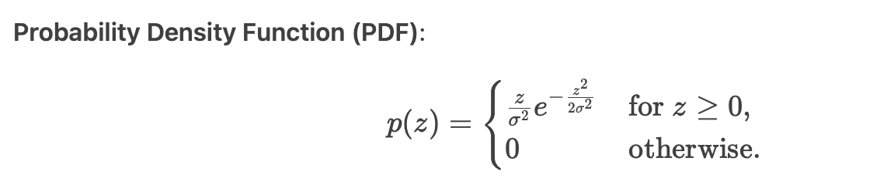
Additional Noise Models
3. Rayleigh Noise
Definition: Noise following a Rayleigh distribution, often seen in MRI and radar imaging.
Characteristics:
Asymmetric distribution (only positive values).
Arises from magnitude-based imaging (e.g., velocity in Doppler radar).
Occurrence:
Medical imaging (ultrasound, MRI).
Wireless communication signals.
Effect on Images:
Blurred edges with a "hazy" appearance.

Slide 12
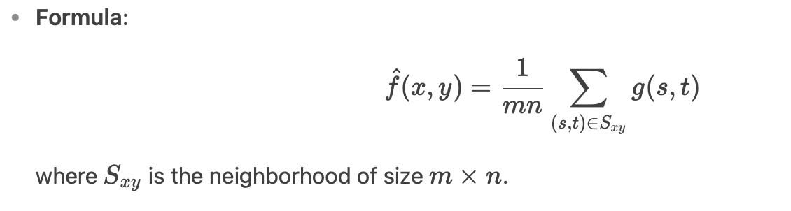
Noise-Only Spatial Filtering
When an image is corrupted by noise-only degradation (no blurring), spatial filtering techniques are applied directly to suppress noise.
These filters operate on a pixel's neighborhood to estimate its true value.
(a) Mean Filter (Arithmetic Mean Filter)
Operation: Replaces a pixel with the average of its neighbors.
Effect: Reduces Gaussian noise but blurs edges.

Slide 13
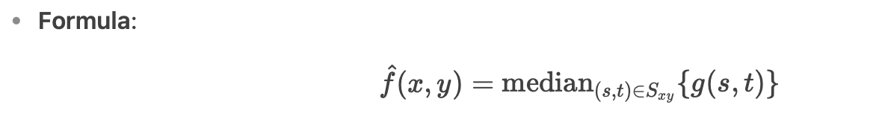

Noise-Only Spatial Filtering
(b) Median Filter
Operation: Replaces a pixel with the median of its neighborhood.
Effect: Effective for salt-and-pepper noise while preserving edges.
(c) Gaussian Smoothing Filter
Operation: Applies weighted averaging using a Gaussian kernel.
Effect: Smoothed Gaussian noise while retaining some edge information.

Slide 14
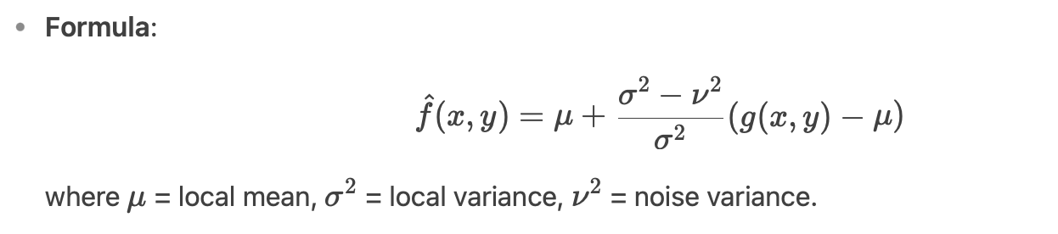
Noise-Only Spatial Filtering
(d) Adaptive Filters (e.g., Wiener Filter)
Operation: Adjusts filtering based on local noise variance.
Effect: Better preservation of edges compared to linear filters.
Choosing the Right Filter
Gaussian Noise → Mean or Gaussian filter.
Salt-and-Pepper Noise → Median filter.

Slide 15
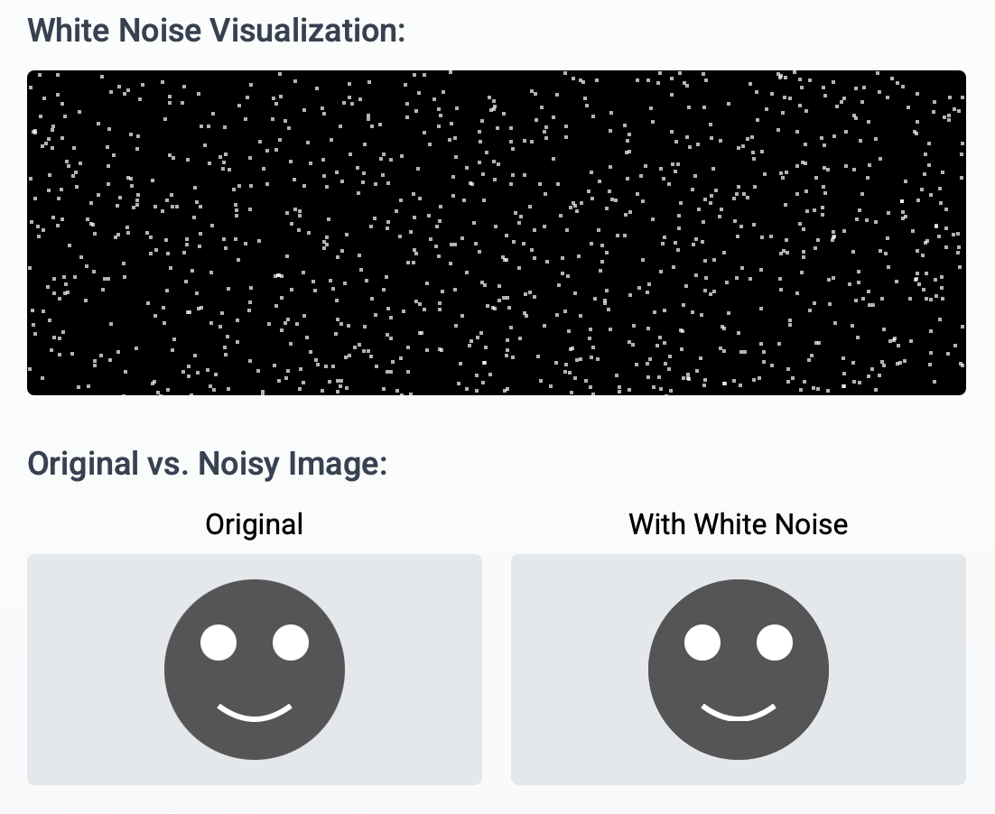
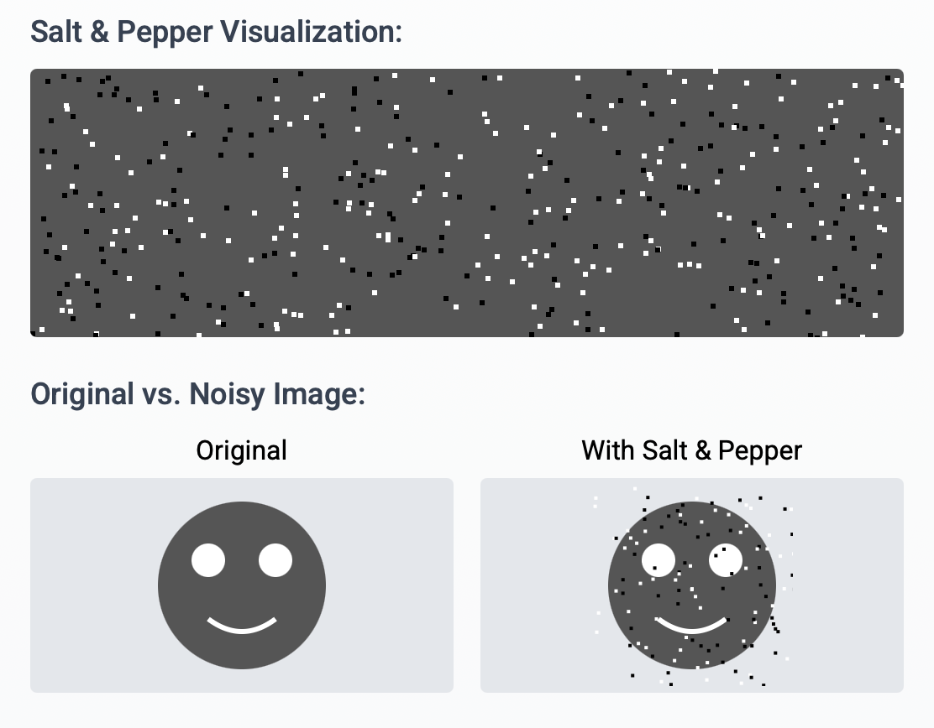
Noise Models

Slide 16
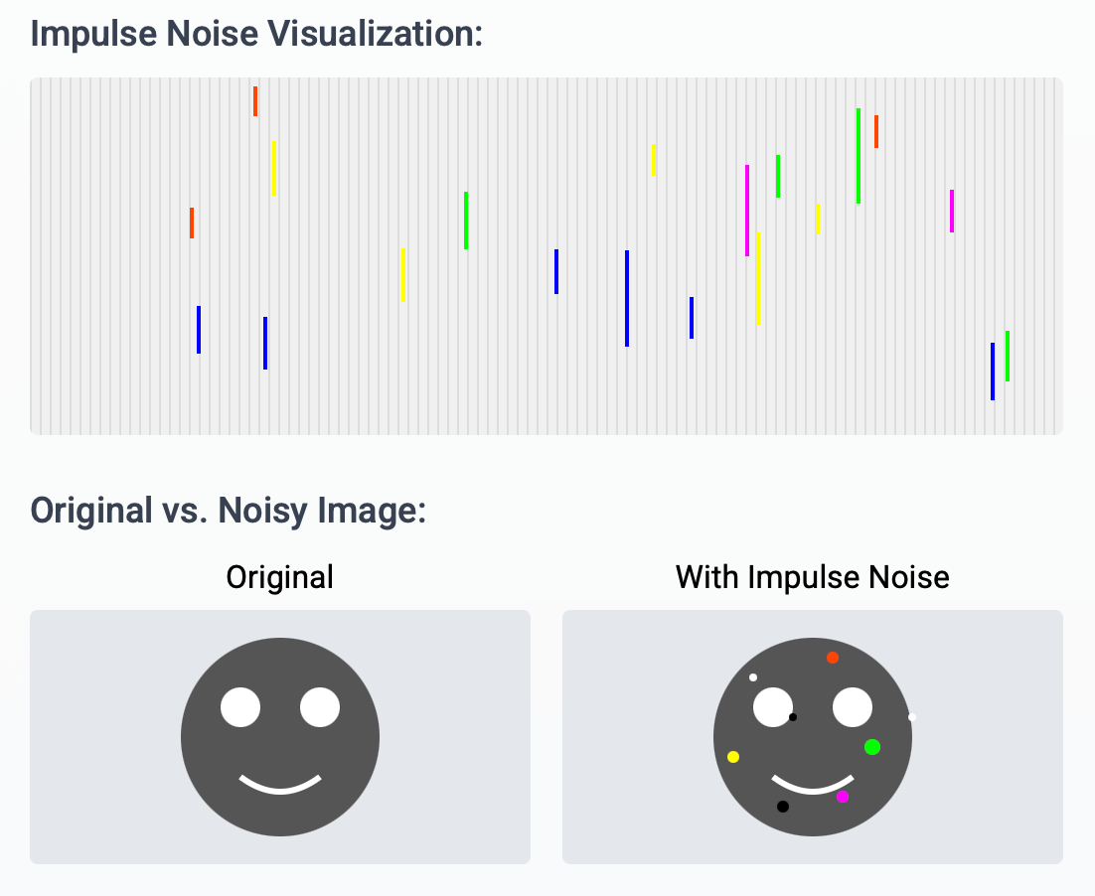
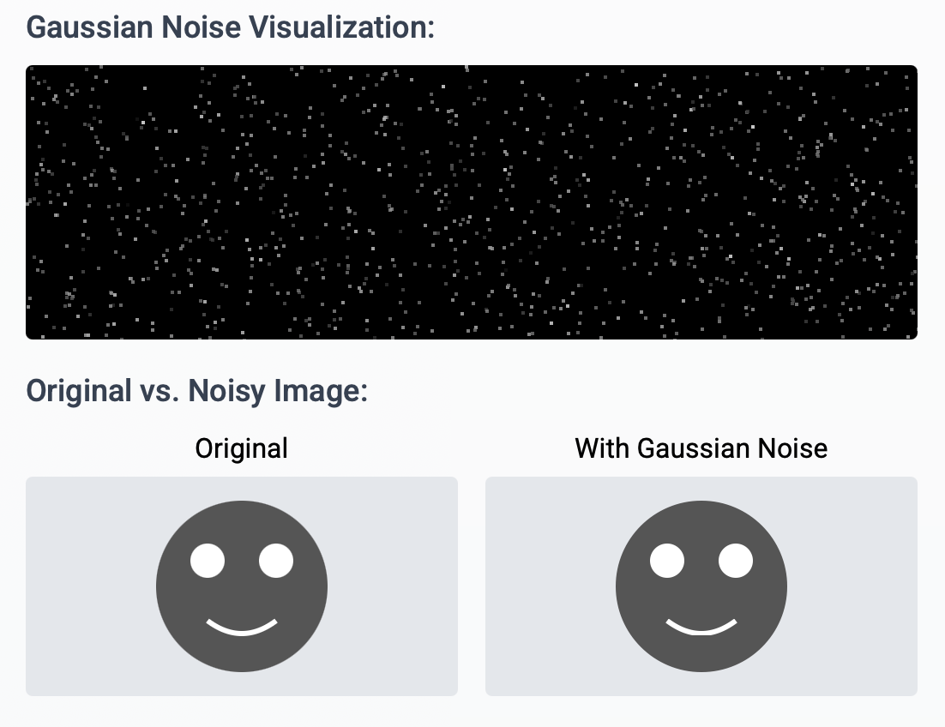
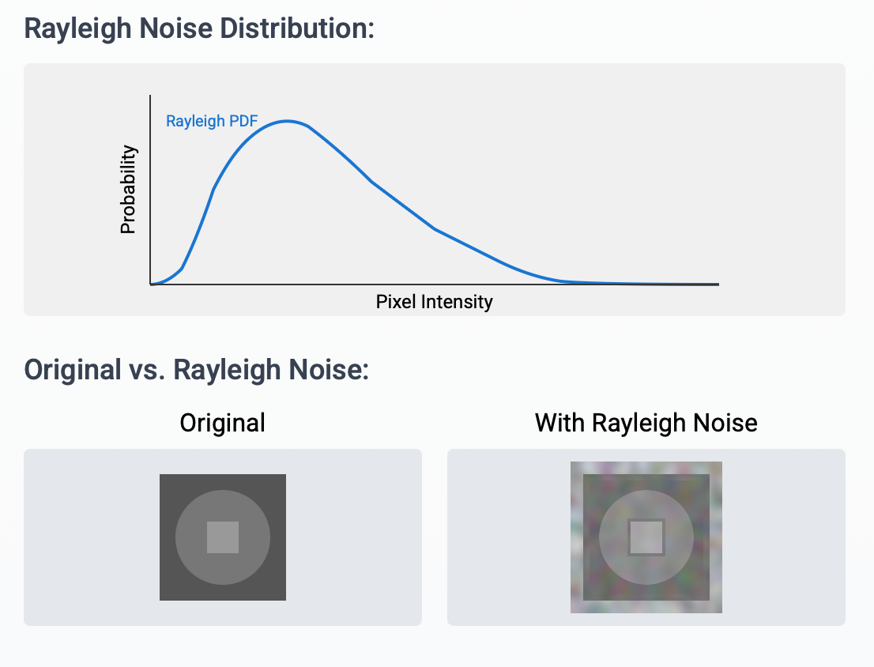
Noise Models

Slide 17
Periodic Noise Reduction by Frequency Domain Filtering
Periodic noise in images appears as repeating patterns (e.g., stripes, waves, or grid-like artifacts) and is often caused by:
Electrical interference (e.g., from power lines).
Mechanical vibrations in imaging systems (e.g., scanners).
Since periodic noise has a distinct frequency signature, it is more effectively removed in the frequency domain rather than the spatial domain.

Slide 18
Steps for Periodic Noise Reduction
Compute the Fourier Transform (FT)
Convert the noisy image g(x,y)to the frequency domain using the Discrete Fourier Transform (DFT):
G(u,v)=F{g(x,y)}
The magnitude spectrum ∣G(u,v)∣reveals bright spots (noise peaks).
Identify Noise Peaks
Periodic noise appears as bright symmetric dots (impulses) away from the DC component (center).
Example:
Vertical stripes → Horizontal impulses in the spectrum.
Horizontal stripes → Vertical impulses in the spectrum.
3. Apply a Frequency Domain Filter
Band-reject filters remove specific frequencies while preserving others.
Common filters:
Notch Filter
Band-Reject Filter
4. Inverse Fourier Transform (IFT)
Convert back to the spatial domain:
f^(x,y)=F−1{H(u,v)⋅G(u,v)}
Where H(u,v) is the filter transfer function.

Slide 19
Periodic Noise Reduction by Frequency Domain Filtering
Filter Types for Periodic Noise Reduction in Frequency Domain
Periodic noise appears as distinct spikes (impulses) in the frequency domain, making frequency-selective filters highly effective.
1. Notch Filters (Most Common for Periodic Noise)
Purpose: Remove specific frequency components while preserving others
Types:
Ideal Notch Reject Filter:
Completely blocks frequencies in small regions around noise spikes
Creates sharp transitions (may cause ringing artifacts)
Formula: H(u,v)=0, if (u,v)(u,v) near noise frequencies H(u,v)=1 otherwise
Butterworth Notch Reject Filter:
Smooth transition between rejected/passed frequencies
Reduces ringing artifacts compared to ideal filters
Order controls steepness of transition
Gaussian Notch Reject Filter:
Smoothest transition characteristics
Minimizes artifacts but has gradual frequency cutoff
Implementation: Typically implemented as pairs (for symmetry) to handle real-valued image transforms

Slide 20
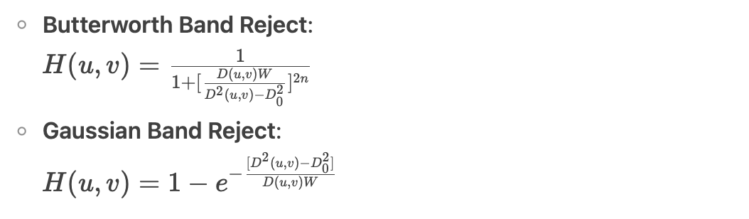
Periodic Noise Reduction by Frequency Domain Filtering
2. Band Reject Filters
Best for: Noise concentrated in annular/ring-shaped frequency bands
Variants:
Ideal Band Reject: H(u,v)=0 if D0−W/2≤D(u,v)≤D0+W/2 H(u,v)=1 otherwise (where D0 = center radius, W = bandwidth)
3. Optimal Notch Filtering (Advanced Technique)
Use notch pass filtering to isolate noise components
Estimate noise pattern via inverse DFT
Subtract noise pattern from original image f^(x,y)=f(x,y)−η(x,y)
(where η is estimated noise)

Slide 21
THANK YOU

Slide 22
End of UNIT 4

